Slide 1

GROUP TWO

Slide 2
Introduction
Convert daily bank transaction into quantity of CO2 emission
Perform ETL process using Azure Databricks
Provide insight for transaction-based on carbon footprint using visualization

Slide 3
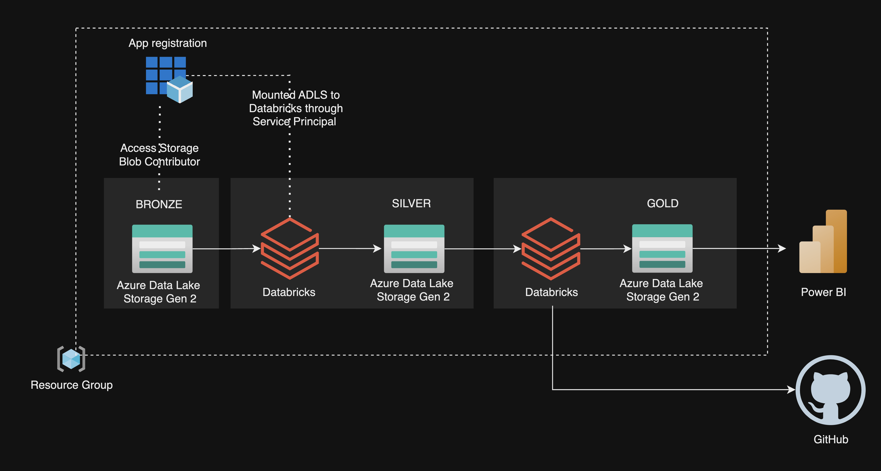
Project Architecture

Slide 4
Preparation and Bronze
Create Azure Data Lake Storage Gen 2
Create Databricks – Standard
Save 4 (four) files into Bronze layer
Mounted ADLS to Databricks using Service Principal

Slide 5
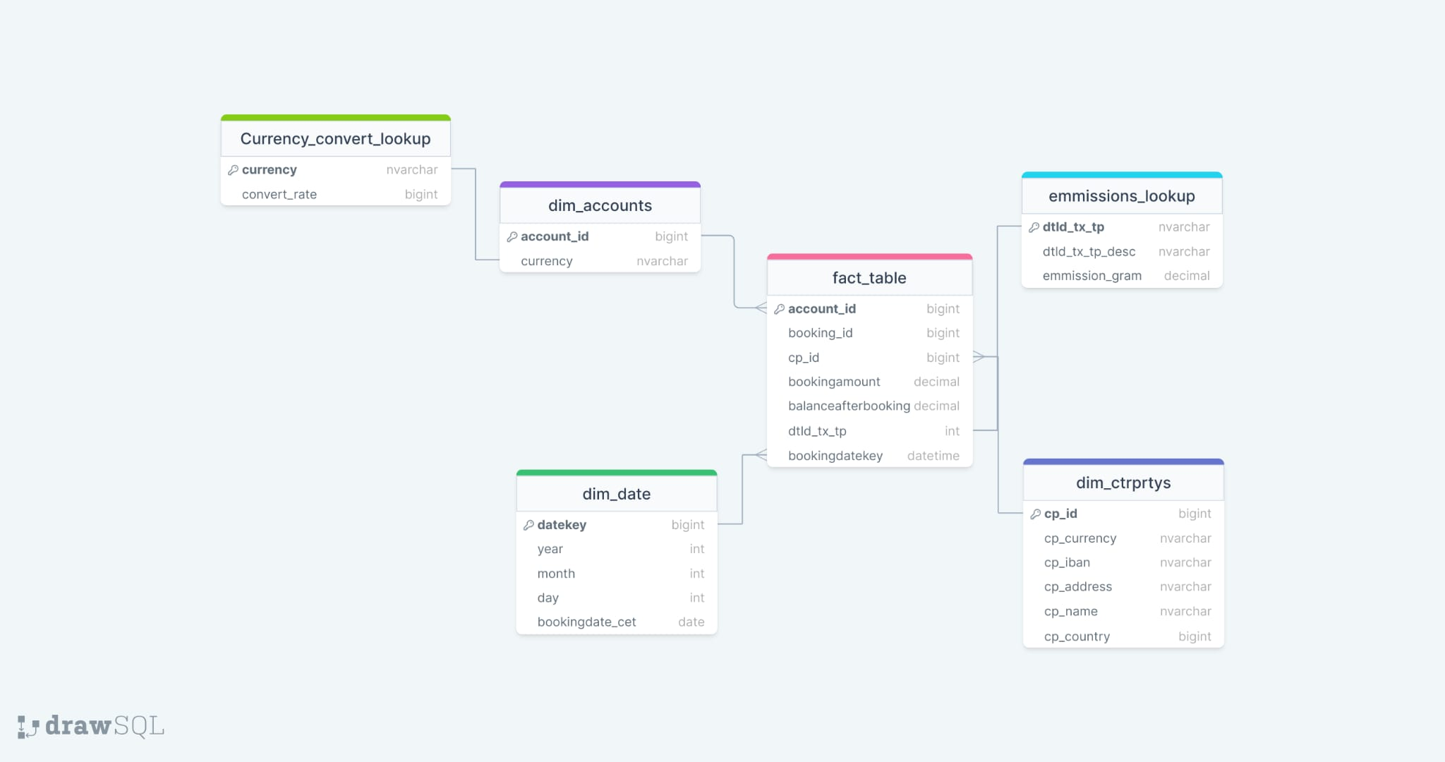
Silver
Snowflake Diagram

Slide 6
Cont’d Silver
Transformation : 1. Renamed Columns 2. Combined the categories.csv & multiplier.csv to become converter lookup tables 3. Fill in missing values in counterparty_currency 4. Remove Duplicate (account and counterparty)
Save as Delta Table in Silver Layer
Create temp Delta table as source for upcoming new file
Perform MERGE operation to update and insert the upcoming files

Slide 7
Gold
Aggregation – Joining tables
Save as Delta Table in Gold Layer
Additional : Visualization on the Notebook

Slide 8
Analysis
Connect ADLS Gold to Power BI
Power BI Report on Desktop
Power BI Service

Slide 9
Continuous Integration with GitHub
Create Repository in the GitHub
Using GitHub to perform Collaboration
Link Databricks to Repository in the GitHub
Clone the Notebook on the Repos

Slide 10
Feedback
More detailed information related to defining the transaction types and categories is needed.
ATM transactions account for the second biggest CO2 emissions. It would be great if we know what they are used for.
Everyone in the team should have access to Azure.

